Slide 1
Functions in Python

Slide 2
First introduction to python functions
Bundle a block of code into a function.
Functions take input variables and generate one output value.
Block of code is only executed when function is called
Make code reusable
Helps to organize your code
General concept that every programming language has
…One of the most powerful concepts in python

Slide 3
Syntax of a python function
Every function consists of 3 main components:
The functions declaration is introduced by def and followed by the functions name.
The input parameters of the function is within () followed by :
The function body contains the code block and must contain a return statement
def function_name (input) :
# function body
return output

Slide 4
Syntax of a python function
Every function consists of 3 main components:
The functions declaration is introduced by def and followed by the functions name.
The input parameters of the function is within () followed by :
The function body contains the code block and must contain a return statement
def function_name (input) :
# function body
return output
The function name should explain what actions are performed in the function

Slide 5
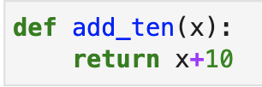
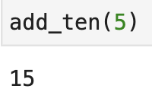
Examples
Our first function adds 10 to a given number x:
Our code is not run until we call the function. This is done by

Slide 6

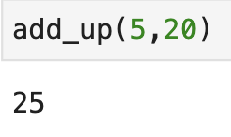
Examples
Let’s extend this function to add up any pair of given numbers x,y:
Let’s call the function ‘add_up’ for 5 and 20:

Slide 7
Why functions are great for data analysis.
Having nice and clean code in a complex data analysis
SQL does not have the same concept of functions
The concept of functions also helps to structure your logical step-by-step thinking when doing data analysis.
It helps you break down complex problems into small solvable tasks
Makes it easy to spot mistakes

Slide 8
Let’s see some hands on examples in a jupyter notebook

